Slide 1
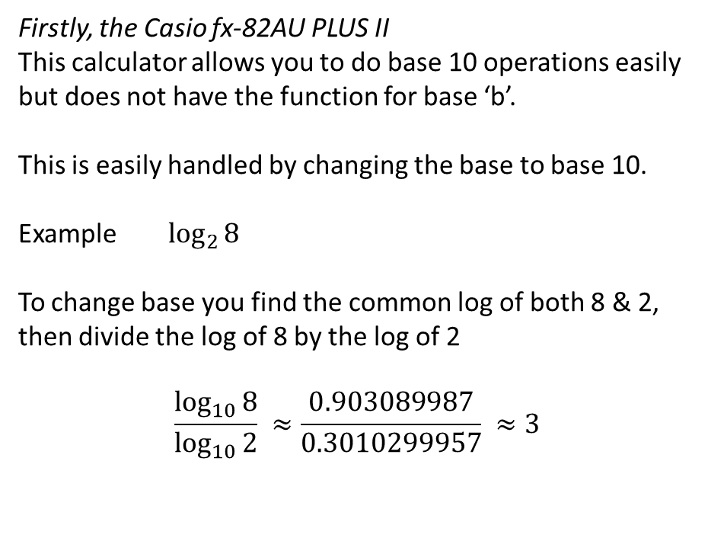
24
7
30
Date
Title - Mini Logarithm lesson 3
EQ – How do you put this all together
Firstly, the Casio fx-82AU PLUS II
This calculator allows you to do base 10 operations easily but does not have the function for base ‘b’.
This is easily handled by changing the base to base 10.
Example $\log_{2}{8}$
To change base you find the common log of both 8 & 2, then divide the log of 8 by the log of 2
$$\frac{\log_{10}{8}}{\log_{10}{2}} ≈\frac{0.903089987}{0.3010299957} ≈3$$
5
Notes:
Input

Slide 2
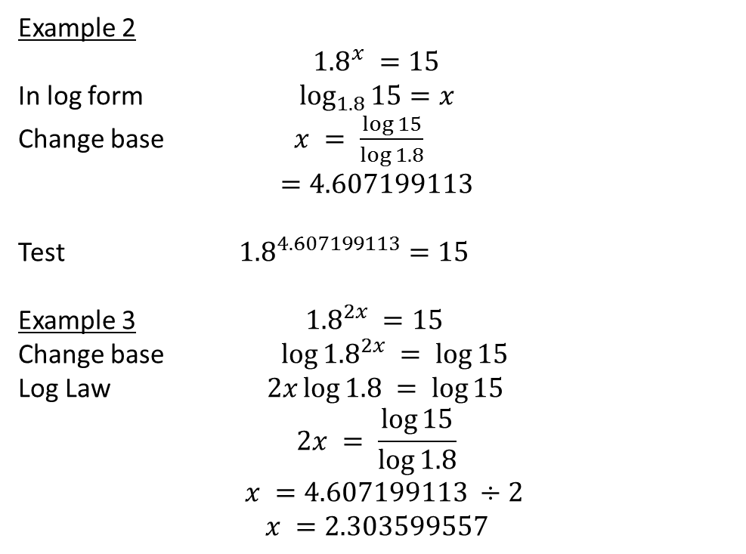
24
7
30
Date
Title - Mini Logarithm lesson 3
EQ – How do you put this all together
Example 2
$${1.8}^{x} =15$$
In log form $\log_{1.8}{15}=x$
Change base $x = \frac{\log{15}}{\log{1.8}}$
$$=4.607199113$$
Test ${1.8}^{4.607199113}=15$
Example 3 ${1.8}^{2x} =15$
Change base $\log{{1.8}^{2x}} = \log{15}$
Log Law $2x\log{1.8} = \log{15}$
$$2x = \frac{\log{15}}{\log{1.8}}$$
$x =4.607199113 ÷2$
$$x =2.303599557$$
5

Slide 3
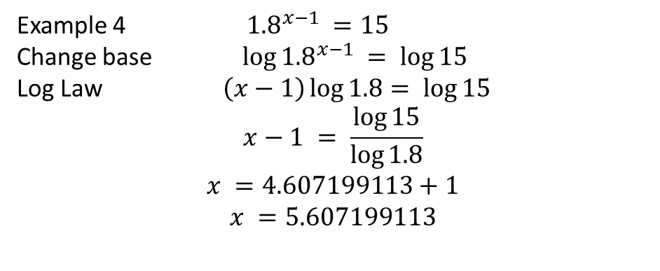
24
7
30
Date
Title - Mini Logarithm lesson 3
EQ – How do you put this all together
Example 4 ${1.8}^{x−1} =15$
Change base $\log{{1.8}^{x−1}} = \log{15}$
Log Law $\left(x−1\right)\log{1.8}= \log{15}$
$$x−1 = \frac{\log{15}}{\log{1.8}}$$
$$x =4.607199113+1$$
$$x =5.607199113$$
5
Notes:
Input

Slide 4
Activity
Nelson – Chapter 1, page 25
Question 20
Dwyer – Page 55
Questions 19 to 23
Notes:
Independent practice

Slide 5
Closure
This lesson is on connect.
Homework – make sure your notes are complete
Complete summary
Complete questions from this lesson
Go to Mathspace and do activities you have not previously completed.
Notes:
Closure

